Slide 1







Scope of the Presentation: Well abandonment
Well abandonment definition
Well abandonment techniques
Different phase for well abandonment
High order evaluation of abandonment practices
Data used for well abandonment
Risk assessment
Recommended best practice

Slide 2
Introduction
The well life cycle start from exploration phase through production phase. Then once the production is no longer available a Plug and Abandonment (P&A) Phase will be initiated to leave the well sealed with minimal risk to the environment.
There exist different type of abandonment:
Temporary Abandonment. Since the intention of a temporary abandonment is to re-enter the well, seeking for a safe manner to perform the activity.
Permanent abandonment, directly infers to an eternal perspective condition.

Slide 3
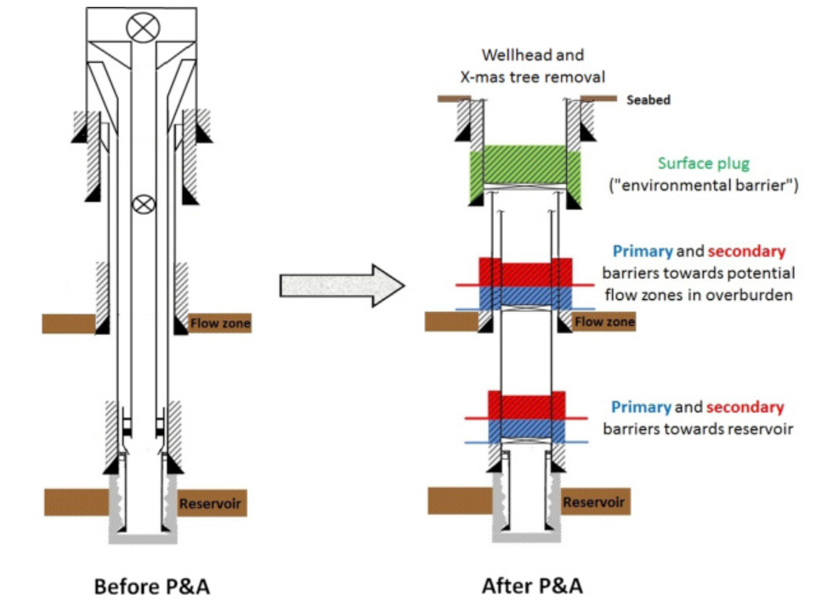
Phase for well abandonment
Operational phase | Contents
Phase 0: Preparatory work | Retrieve tubing hanger plugs, kill well, install deep set mechanical plug, punch/perforate tubing, circulate well clean
Phase 1: Reservoir abandonment | Rig up BOP, pull tubing hanger and tubing, install primary barrier with its base at top of influx zone (i.e. reservoir), install secondary barrier where the base of barrier can withstand future anticipated pressures
Phase 2: Intermediate abandonment | Remove casing strings (if necessary), install primary and secondary barriers towards potential flow zones in overburden, install surface plug ("environmental barrier")
Phase 3: Wellhead and conductor removal | Cut conductor and casing strings below seabed to avoid interference with marine activity, retrieve casing strings, conductor and wellhead
Fig. 1. Simplified illustration of a typical offshore
production well before and after P&A. (TorbjørnVrålstad et al, 2019)

Slide 4
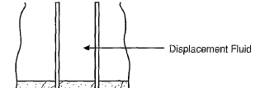
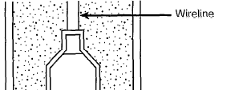
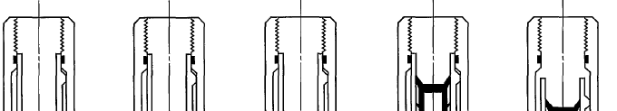
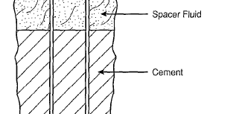
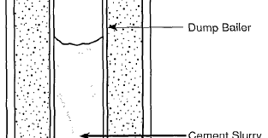
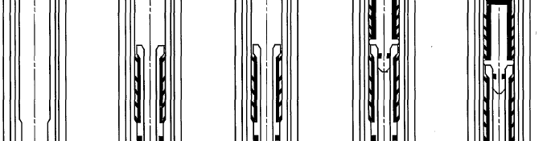

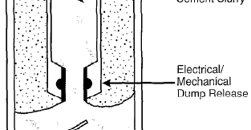
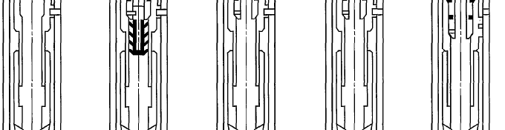
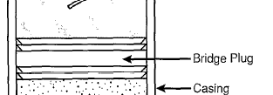
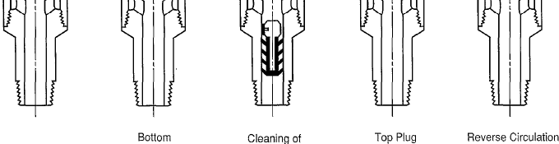
The quality and performance of a P&A operation may be investigated by two points of view; type of plugging material and plug placement technique.
Plugging techniques
Balanced plug method
Dump Bailer method
Two-plug method
Type of material used defines the type of plug placement technique. There are several cement plug placement techniques that are used in the abandonment process (Smith 1993; Nelson 2006):
Cement squeeze method

Slide 5
Process of well abandonment practice
Operational P&A procedure may differ significantly from well to well, depending on the type of well and the actual well conditions. Here we summary different process steps for well abandonment according to Norwegian regulation NORSOK D-010
Step | Process
First step | The well is prepared for P&A by circulating high density drilling fluid and installing deep set mechanical plug, before the barriers towards the reservoir are installed. A well-regulated area such as the North Sea requires two independent barriers towards the reservoir (NORSOK D-010, 2013; Oil & Gas UK, 2015b), where the primary and secondary barriers shall not have common well barrier elements.
Second step | Any fluid-bearing formations in the overburden, such as high-pressure zones and hydrocarbon-containing formations, are also isolated with two independent barriers. Furthermore, an openhole-to-surface plug (also called the “environmental barrier”) is installed below the seabed, which prevents any residual fluid contamination to the environment.
Final step | the conductor and wellhead are removed.

Slide 6
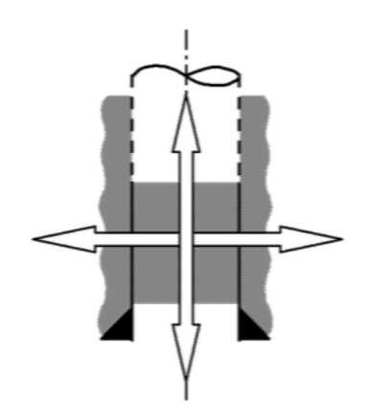
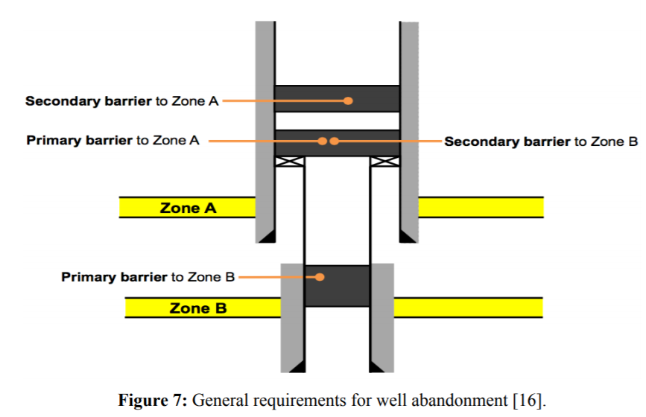
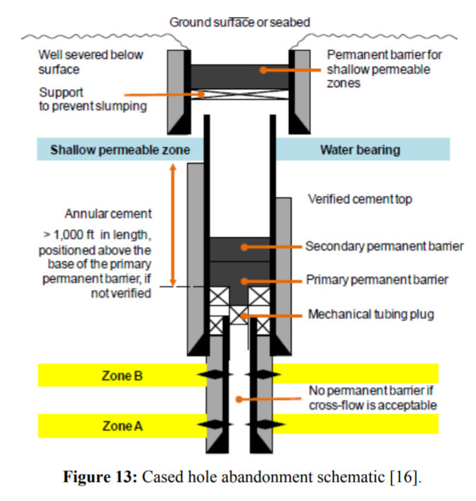
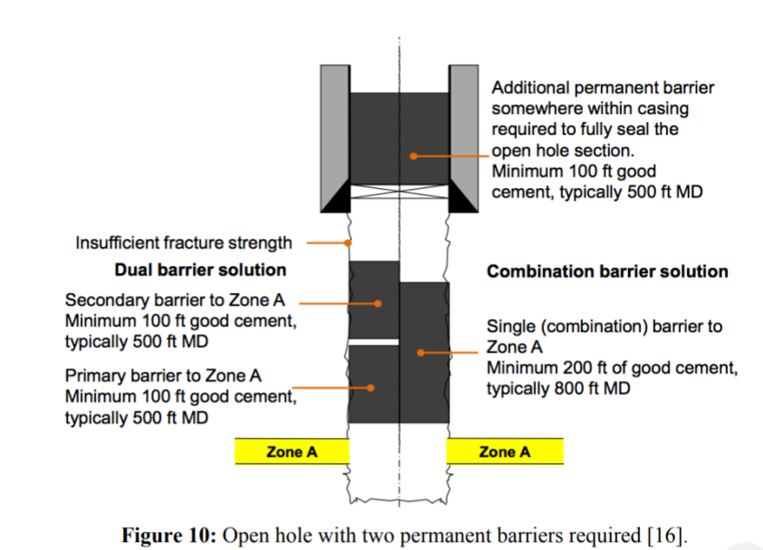
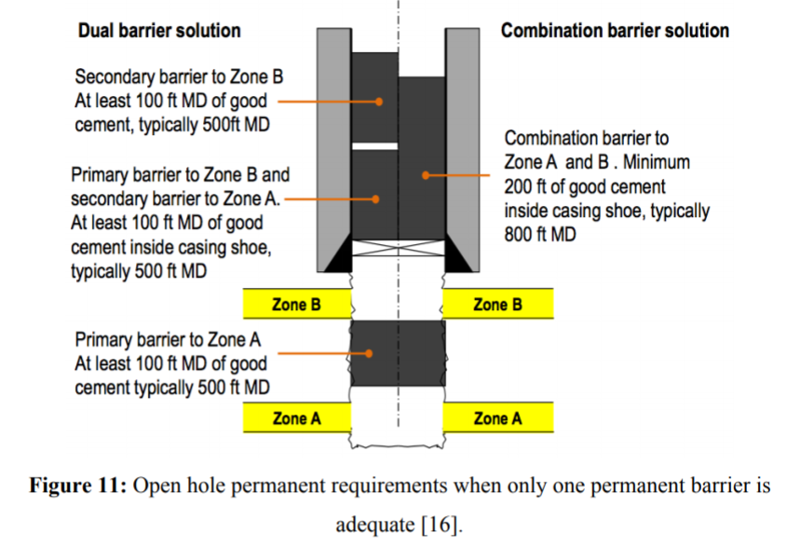
Well barriers
Permanent plugged wells must be abandoned with a lasting perspective considering the effects of any foreseeable chemical and geological processes. NORSOK D-010 Rev.4 [13] and ANP`s Resolution 46/2016 [14] state that control cables and lines must be removed from the intervals where permanent well barriers are set since they can create vertical leak paths through the barrier.
Requirements of permanent well barriers A permanent well barrier must be placed adjacent to an impermeable formation and must extend across the full cross section of the well, including all annuli and seal in both vertical and horizontal directions as presented in Figure 6.
Material Requirements NORSOK Standard D-010 Rev.4 recommends that a permanent well barrier should have the following characteristics:
• Provide long term integrity;
• Impermeable;
• Able to withstand mechanical loads;
• Adherent to the casings and reservoir formations around them;
• Resistant to chemicals and substances such as H2S, CO2 and hydrocarbons;
• Non-shrinking; • Wetting to ensure bonding to steel;
• Not harmful to the integrity of steel tubular.
Tatiana Vieira do Paço Hallak, 2017
Position requirements
Open hole
Cased hole

Slide 7
Abandonment practice
Majority of operators has not been taking into account potential second life applications when abandoning
However, some operators recently started to evaluate field’s value for future purposes prior to abandonment
Company practices closely reflect governing regulations; more stringent measures (e.g. longer plug lengths, advanced materials) may be applied, especially in corrosive environments

Slide 8
Data availability
Majority of respondents (a single exception) indicated that for 90- 100% of the wells data is available on:
Well location (coordinates)
Present well status
Well configuration (i.e. cased depths, top of cement, plug lengths, materials applied)

Slide 9
Well Abandonment Regulations
Literature research of well abandonment requirements in international regulations and a selected number of countries/states with petroleum history, including;
Australia
Canada
China
Europe (e.g. Denmark, Netherlands, Norway, UK)
Japan
USA (Alaska, California, Texas)
Data obtained of plug lengths and position requirements used in;
the transition zone from uncased to cased sections
reservoir (uncased) section
perforated cased sections

Slide 10
Selection of minimum plug requirements
Transition zone from uncased to cased sections;
Europe; 50-100 m, except UK; 30 m
International; 30-60 m, except Canada; 15 m depending on formation
Reservoir (uncased) section
Europe and International; 50-100 m, except UK and Canada; 30 m
Perforated cased sections
Europe; 50-100 m, except UK; 30 m
International; 30-60 m, except
Remarks on review of abandonment regulations
Assessment of the regulatory framework provides a first order proxy for initial identification of abandonment practices only
Cement plug is compulsory in all evaluated regulatory documents
Main differences involve plug requirements (lengths) at the level of the deepest casing shoe
The application of mechanical plugs often require additional cementing (exact requirements differ significantly among regulations)

Slide 11
Risk Management: assessment
wells involved needs to be confidently assessed
previously abandoned wells including Evaluation of abandonment configuration with respect to second life application
Evaluation of current state of materials and placement, extrapolating from data gathered prior to abandonment

Slide 12
Risk Management: assessment
The methodology for risk-based assessments consists of five steps:
Plugging material | Method
1 | establishing the risk context,
2 | performing a risk analysis
3 | identifying well barrier failure mo
4 | performing a risk evaluation, and conducting

Slide 13
Risk Management: assessment
a3.4. Risk-based approach to P&A?
An important issue regarding plug integrity is the plug length.
It depend according to different countries and regulatory regimes.
In North sea for example, at Nowegian side the plug length Iis 100 m and 30 m at UK side
The P&A procedure can therefore be tailor-made to fit each unique well, and an advantage of such a risk-based approach is the potential for considerable cost savings, as less stringent requirements may be sufficient for “simple” wells.
).

Slide 14
As mentioned earlier, performing a risk assessment of P&A wells includes quantifying the probability of leakage and the leakage rate. To quantify the probability of leakage, the recommended solution is to use a Bayesian approach together with the Weibull distribution. This method allows the use of only censored data as there are no leaks reported in P&A wells on the NCS. With this approach, one can also include prior information available from experts, models etc. In addition, this method takes into account that the probability changes with time, as one assumes an increasing failure rate
As an alternative to this “one-size-fits-all", prescriptive approach to plug length (and the number of plugs), a risk-based approach to P&A has been suggested (Buchmiller et al., 2016; Fanailoo et al., 2017; Arild et al., 2017). This approach accounts for the fact that all wells are different with respect to for example flow potential and pressure difference, and provides a “fit-for-purpose" alternative. In such a risk-based approach, different P&A solutions are evaluated in terms of the probability that the permanent barrier system will fail within a given time-frame (Arild et al., 2017).

Slide 15
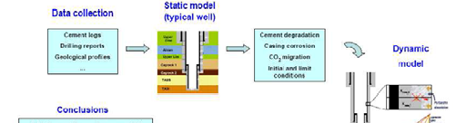
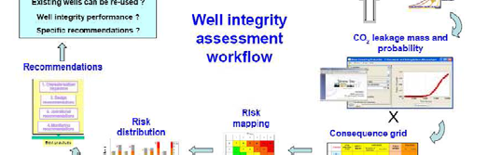
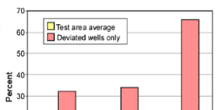

Risk assessment methodologies
Qualitative RA
FEP (Feature, Event, Process) analysis t
identify site-specific CO2 storage related
TNO CASSIF, Quintessa)
Quantitative RA
Deterministic (applicable to small numbers of wells)
Probabilistic (applicable to large sets of wells; e.g. OXAND methodology)
Semi-quantitative: e.g. data mining

Slide 16
Plugging materials
Plugging material | Descriptions
Portland cement | Most commonly used plugging material worldwide. Consists mainly of calcium hydroxide ("portlandite") and various calcium silicate phases. Addition of selected additives enables a wide range of different specialised cement systems such as expandable cements and flexible cements.
Blast Furnace Slag (BFS) | This waste product from steel manufacturing process has been used in well cementing applications, by itself and as additive to Portland cement. Not widely used as plugging material.
Bentonite | Bentonite has been applied as plugging material due to its ability to swell and its low permeability.
Low melting point metal alloys | Bismuth containing low melting point metal alloys has been suggested as a potential plugging material. An advantage would be a good metal-to-metal bond to casings.

